Slide 1
GIANT BICYCLE COMPANY
BUSINESS INTELLIGENCE ANALYSIS
NEAW AIK KA TP065116
APU2F2211CS(DA)

Slide 2
01
COMPANY INTRODUCTION

Slide 3
COMPANY BACKGROUND
Taiwan-based OEM established in 1972
Vast distribution across North America, Australia, Asia, and Europe
Relies heavily on resellers for sales and marketing
29 employees in sales and marketing department
Initiating improvement of e-commerce platform
Aiming for global brand exposure and increased sales

Slide 4
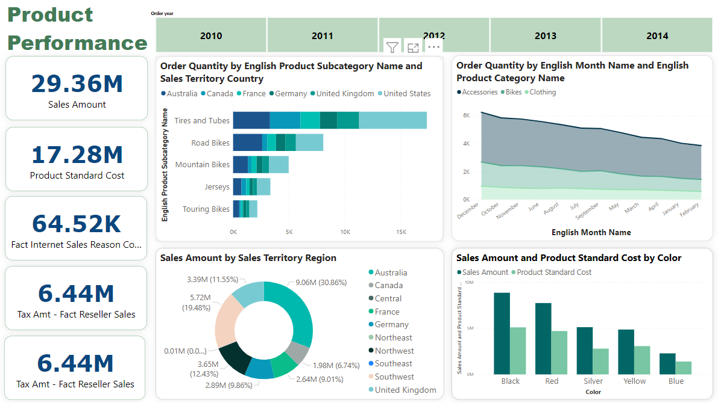
FINDING 1

Slide 5
REASONS
The prevalence of flat tires in the US and Australia could be due to either bike design issues or poor road conditions in these regions.
The majority of Giant Bike's customers are road cycling enthusiasts, predominantly teenagers or middle-aged individuals.
Increased sales during the last quarter might be attributed to end-of-year promotions or holiday shopping.
High online sales in Australia and the southwest US could result from better internet access, online shopping behaviors, or a reliable delivery system in these regions.

Slide 6
RECOMMENDATIONS
Product Development and Strategy
Operational and Marketing Strategy
Enhance the durability of tires and tubes and design bikes to be more resistant to tough road conditions.
Focus on designing road bikes tailored to the preferences of the primary customer demographic (teenagers and middle-aged individuals). Explore opportunities to diversify and appeal to other demographics.
Leverage the popularity of black-colored products by applying similar design and promotional strategies to other product lines.
Amp up promotional efforts and stock inventory in preparation for the sales peak during October, November, and December.
Allocate additional resources and manpower during high-demand periods, especially December.
Harness the influence of the company website, particularly in regions like Australia and the southwest US, through targeted marketing and possibly enhanced online shopping features. Ensure delivery quality and reliability in these regions to maintain consumer trust.

Slide 7
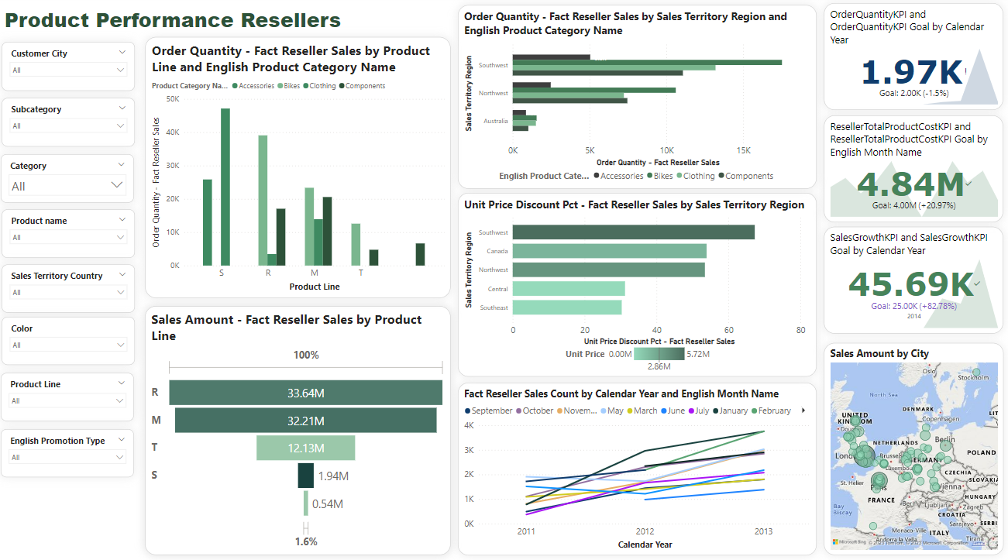
FINDING 2

Slide 8
REASONS
Attractive discounts might drive higher sales in Southwest America.
External factors in specific months, such as September and January, could boost sales in 2013.
RECOMMENDATIONS
Implement targeted discount strategies, like introducing new products with appealing discount plans, especially in areas like Southwest America.
Regularly review and assess selling performance, especially during declining periods, to identify and address underlying causes for reduced sales.

Slide 9
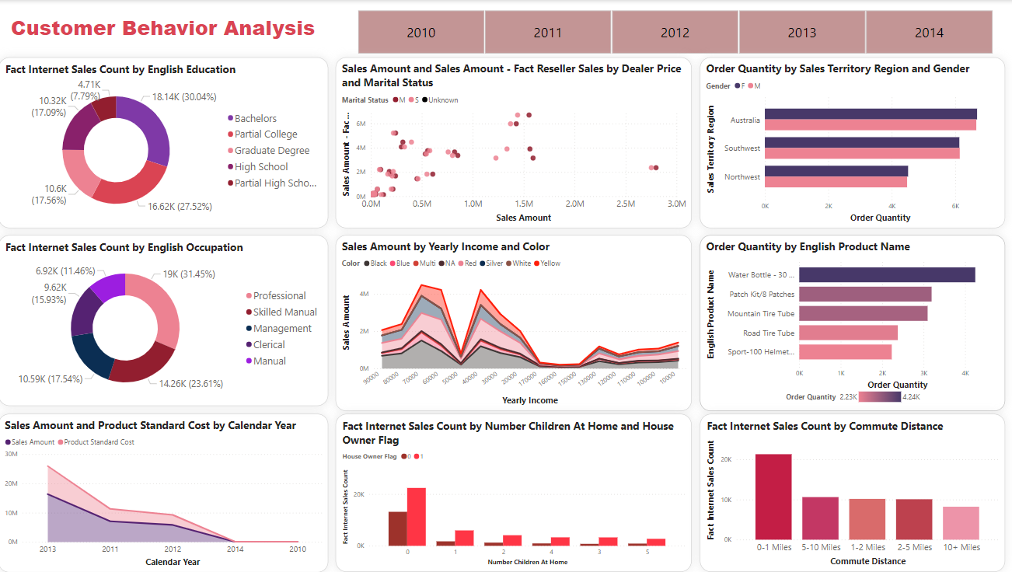
FINDING 3

Slide 10
REASONS AND RECOMMENDATIONS
POSSIBLE REASONS
RECOMMENDATIONS
Sales performance degradation may be due to reduced advertisement spending or compromised product quality due to cost-cutting.
Focus on designing products like aesthetic water bottles catering to students and office workers, and set pricing based on dominant customer income brackets.
Reevaluate cost-cutting strategies, ensuring a balance between maintaining product quality and ensuring effective marketing.
Students and white-collar workers likely bring Giant Bike bottles to college or workplace.

Slide 11
CONCLUSION
Support Giant Bike's OLAP integration to strengthen their market position.
Analyze sales and manufacturing to identify reasons for recent sales decline.
Examine customer behavior to influence product design and market positioning.
Highlight operational challenges and market demands for better product strategy.
Provide recommendations to enhance the company's overall performance.
Assist resellers with strategic suggestions to improve sales.
Use OLAP and data analysis to guide Giant Bike in making informed decisions and maintaining market relevance.

Slide 12
THANKS!

